Slide 1
WALMART SALES FORECASTING
CAPSTONE PROJECT
Presented By:
Sanya Bhanot
- Bharati Vidyapeeth’s College of Engineering, New Delhi
- B.TECH (Computer Science & Engineering)

Slide 2
OUTLINE
Problem Statement
Proposed System/Solution
System Development Approach
Algorithm & Deployment
Result
Conclusion
Future Scope
References

Slide 3
PROBLEM STATEMENT
Walmart is a renowned retail corporation that operates a chain of hypermarkets. Here, Walmart has provided a data combining of 45 stores located in different regions including store information and monthly sales. Each store contains a number of departments and the task is to predict the department-wise sales for each store. The data is provided on weekly basis. In addition, Walmart runs several promotional markdown events throughout the year. These markdowns precede prominent holidays, the four largest of which are Christmas, Thanksgiving, Super bowl and Labor Day. The weeks including these holidays are weighted five times higher in the evaluation than non-holiday weeks. Part of the problem is modelling the effects of markdowns on these holiday weeks in the absence of complete/historical data.

Slide 4
PROPOSED SOLUTION
The proposed system aims to address the challenge of predicting department-wise sales for each store on a weekly basis. This involves leveraging data analytics and machine learning techniques to forecast demand patterns accurately. The solution will consist of the following components:
Data Collection
Gather historical data on department-wise sales, including time, date, location, and other relevant factors.
Utilize real-time data sources, such as events, and holidays, to enhance prediction accuracy.
Data Preprocessing
Clean and preprocess the collected data to handle missing values, outliers, and inconsistencies.
Feature engineering to extract relevant features from the data that might impact bike demand.
Machine Learning Algorithm
Implement a machine learning algorithm, such as a time-series forecasting model , ARIMA, to predict weekly sales based on historical patterns.
Consider incorporating other factors like month of the year, day of the week, and special events to improve prediction accuracy.
Deployment
Develop a user-friendly interface or application that provides real-time predictions for weekly sales at different dates..
Deploy the solution on a scalable and reliable platform, considering factors like server infrastructure, response time, and user accessibility.
Evaluation
Assess the model's performance using appropriate metrics such as Mean Absolute Error (MAE), Root Mean Squared Error (RMSE), or other relevant metrics.
Fine-tune the model based on feedback and continuous monitoring of prediction accuracy.

Slide 5
SYSTEM APPROACH
System requirements
Hardware Requirements
CPU: Intel Core i5 or AMD Ryzen 5
RAM: 8GB or more SSD 256 GB
GPU: NVIDIA GeForce GTX 1060 or AMD Radeon RX 580
Internet Connectivity: A minimum download and upload speed of 10 Mbps is generally recommended
Software Requirements
Operating System: Windows 10 or above, Linux, or macOS .
IDE: Jupyter Notebook, Flask, Google Colab, Dash.
Library required to build the model
Python: A popular programming language for machine learning provides libraries such as Pandas, NumPy, Scikit-learn, Arima etc
Visualization tools: Matplotlib, Seaborn.

Slide 6
ALGORITHM & DEPLOYMENT
Algorithm Selection
ARIMA is a popular method of modeling time series, because of its flexibility and generalizability. The primary goal of this project was to examine a method to use fewer than 100 non-seasonal ARIMA models to generate weekly forecasts for over 3000 individual series, over the span of one year.
Data Input
The dataset used in this project contained five features:
Store: integer values to identify individual stores.
Dept: integer values to identify specific departments (not unique per store).
Date: strings of the form yyyy-mm-dd, meant to indicate the week of month and year.
Weekly_Sales: floats giving the sales recorded for that week, in dollars.
IsHoliday: Boolean (True/False) for if a major holiday occurred during that week.
Training Process
The algorithm is trained using historical data using techniques such as feature selection or feature importance determining the model will train better with the whole dataset or by dropping specific columns..
Prediction Process
Automated selection was achieved by iterating over each series, and fitting each to all order combinations, with values from zero to two. The models were evaluated, and orders selected, using Akaike Information Criterion (AIC). The process is made more accurate by using Exponential Smoothing.

Slide 7
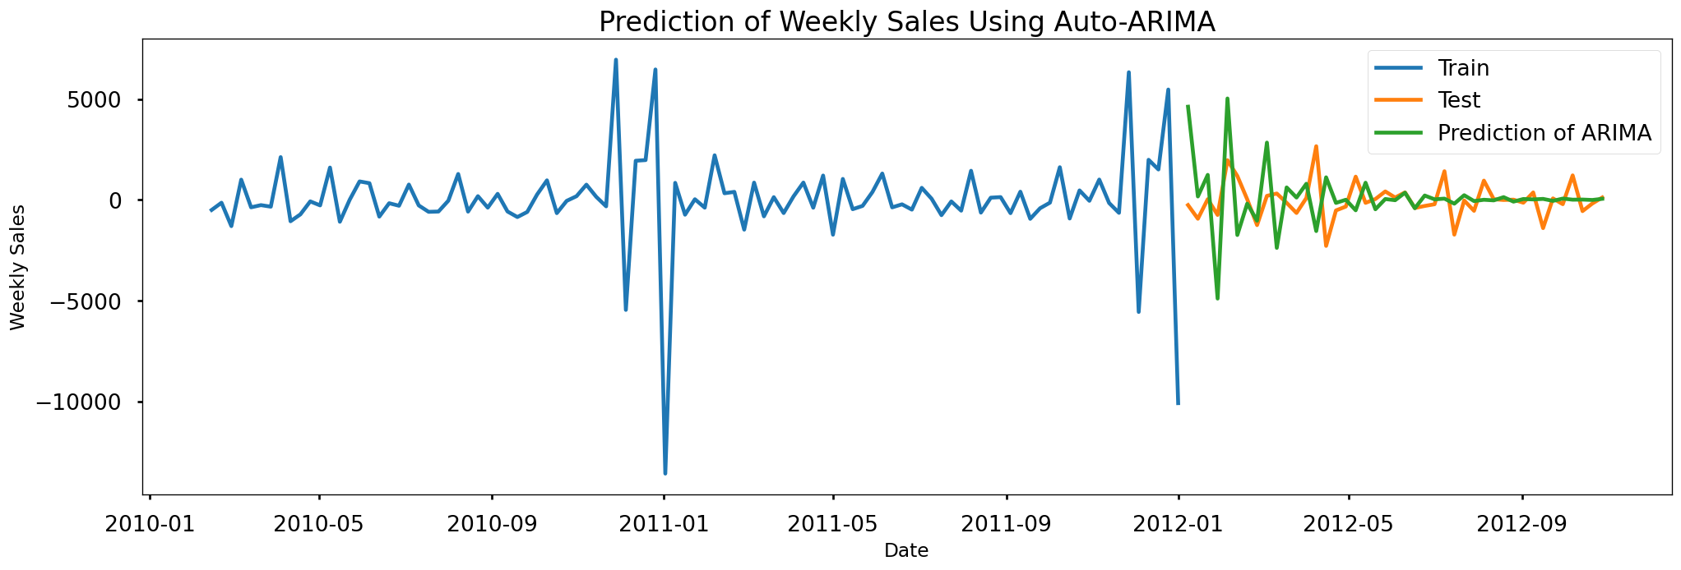
RESULT
Graph showing prediction of weekly sales using auto-Arima model. The prediction lines are not that aligned to the test data.

Slide 8
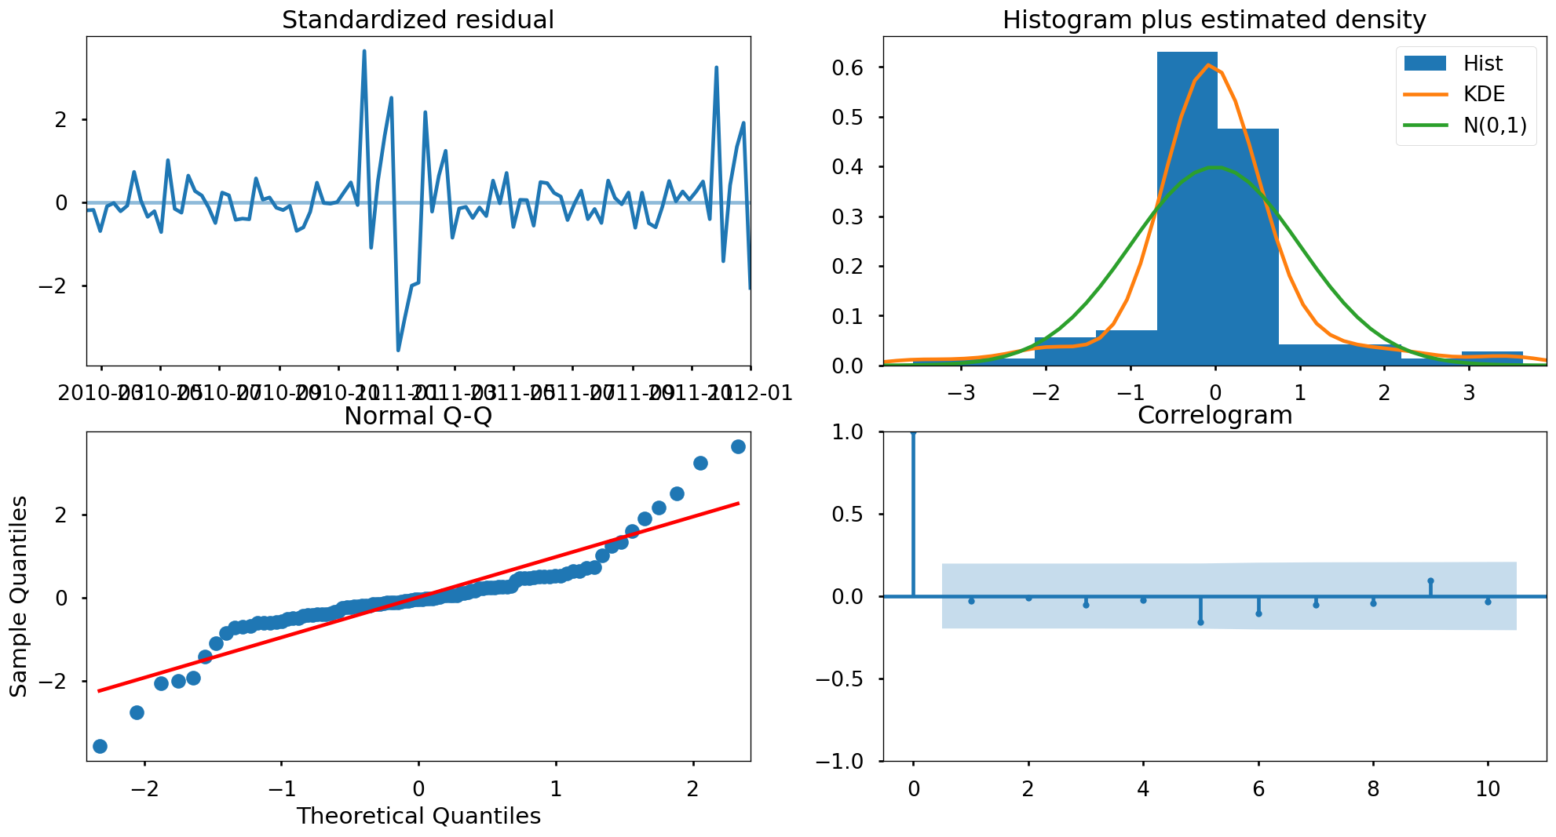
RESULT
Diagnostics of auto Arima model-

Slide 9
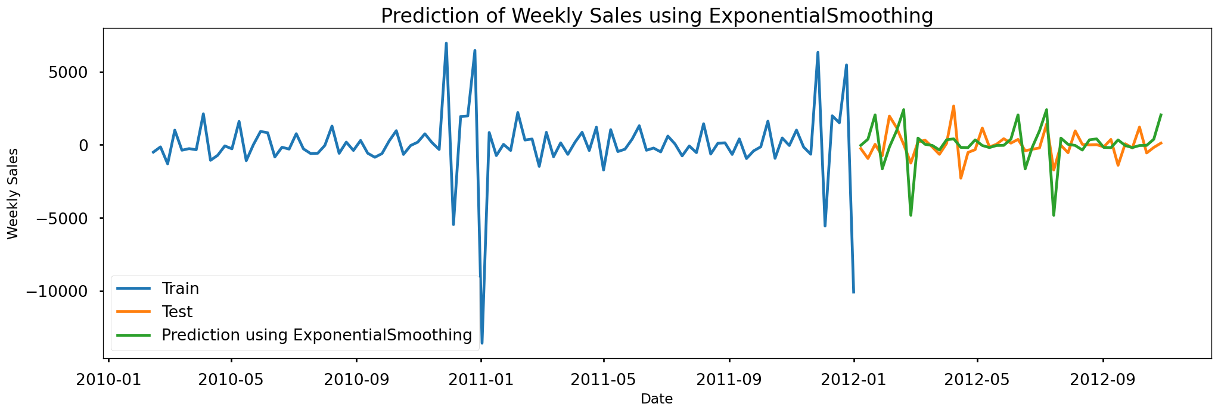
RESULT
Graph showing prediction of weekly sales using Exponential Smoothing. The lines are more aligned to the testing data.

Slide 10
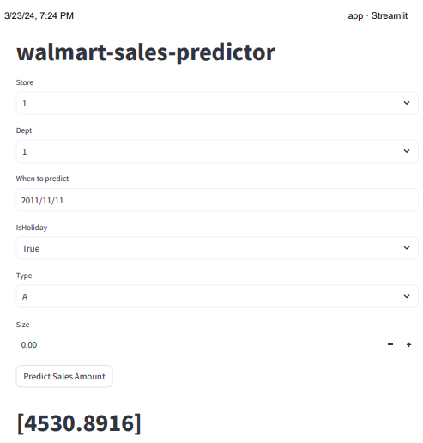
RESULT
Model Deployment using Streamlit

Slide 11
CONCLUSION
In conclusion, some departments has higher sales, on average others can be best. It shows us, some departments has effect on sales on some seasons like Thanksgiving.
It is same for stores, means that some areas has higher seasonal sales.
Stores has 3 types as A, B and C according to their sizes. Almost half of the stores are bigger than 150000 and categorized as A. According to type, sales of the stores are changing.
As expected, holiday average sales are higher than normal dates.
Top 4 sales belongs to Christmas, Thanksgiving and Black Friday times. Interestingly, 22th week of the year is the 5th best sales. It is end of May and the time when schools are closed.
Christmas holiday introduces as the last days of the year. But people generally shop at 51th week. So, when we look at the total sales of holidays, Thanksgiving has higher sales between them which was assigned by Walmart. But, when we look at the data we can understand it is not a good idea to assign Christmas sales in data to last days of the year. It must assign 51th week.
January sales are significantly less than other months. This is the result of November and December high sales. After two high sales month, people prefer to pay less on January.
CPI, temperature, unemployment rate and fuel price have no pattern on weekly sales.

Slide 12
FUTURE SCOPE
Data will be made more stationary with different techniques.
More detailed feature engineering and feature selection will be done.
More data can be found to observe holiday effects on sales and different holidays will be added like Easter, Halloween and Come Back to School times.
Markdown effects on model will be improved according to department sales.
Different models can be build for special stores or departments.
Market basket analysis can be done to find higher demand items of departments.

Slide 13
REFERENCES
Tingli Feng, Chenming Niu, Yuchen Song, "Short Term E- commerce Sales Forecast Method Based on Machine Learning Models", Proceedings of the 2022 6th International Seminar on Education, Management and Social Sciences (ISEMSS 2022), pp.1020, 2022.
Md. Anisur Rahman Mia, Mohammad Abu Yousuf, Rupon Ghosh, "Business Forecasting System using Machine Learning Approach", 2021 2nd International Conference on Robotics, Electrical and Signal Processing Techniques (ICREST), pp.314- 318, 2021.
Pei Guo, Aly Megahed, Shubhi Asthana, Paul Messinger, "Winnability Prediction for IT Services Bids", 2019 IEEE International Conference on Services Computing (SCC), pp.237- 239, 2019
Mrithula Nandhini Devi, Hari Haran , Praveen Kumar, “Future Sales Forecasting Using Arima Model”, International Journal of Research Publication and Reviews, Vol 4, no 5, pp 210-215 May 2023.
Dr. Lutful Islam, Mohammad Farzan Farooqui , Ayyan Khan, Mohammad Wasi, Tousif Shaikh, “Walmart Sales Analysis and Prediction”, International Journal of Advanced Research in Science, Communication and Technology (IJARSCT), April 2023

Slide 14
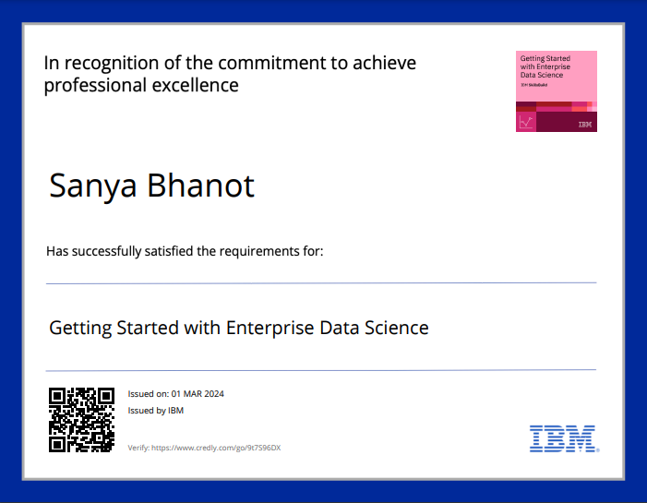
COURSE CERTIFICATE 1

Slide 15

COURSE CERTIFICATE 2

Slide 16
THANK YOU

